Slide 1
Malware Classification using Machine Learning and Deep Learning Techniques
A Collaborative Project By:
Aryan Bansal (2K18/SE/038)
Ashish Kumar (2K18/SE/041)

Slide 2
Outline
Problem Statement
Data Overview
Feature Extraction
Model Architectures
Results
Deployment
Conclusion
References

Slide 3
Problem Statement
Problem statement
The most common defenses against malware threats involves the use of signatures derived from instances of known malware.
But now we are encountering more and more malware coming from sophisticated developers that evade signature detection. Thus all good antimalware software these days must employ some sort of heuristic algorithms to prevent zero day attacks.

Slide 4

Our Contribution
The main idea is to extract important features by performing static analysis techniques on the malwares and legitimate files.
Comparing the performance of various machine algorithms to differentiate legitimate files (benign) from malware.
Developing a voting classifier which will take the majority vote of all the algorithms as the final verdict. Finally, we will deploy the web app for public use.
Technologies and Dependencies: Machine Learning, Deep Learning, Python, Google Colab, Sklearn, Keras, pefile, streamlit, NGROK.

Slide 5
Flow Diagram
Deployment
Deploying the finally selected models to be used by other applications.
Data Collection
Collection of Primary and Secondary data, labelling the programs as benign or malware with respect to certain features.
05
01
04
Testing
Testing our selected models over previously unseen data, for final testing, using the principle of majority voting.
Feature Extraction
Extraction of Necessary and valuable features from the data, which can be used to train our machine learning and deep learning models.
02
03
Training and Validation
Training multiple models to classify the programs with respect to the features and then validating our models.

Slide 6
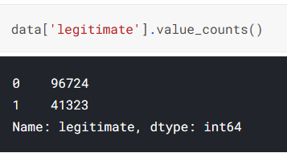
Data Acquisition and Storage
The dataset consists of legitimate and malicious files. For legitimate file, we gathered 41323 Windows binaries (exe + dll) and for malicious files, we gathered 96724 different PE files from a part of Virus Share collection : 134th archive . The legitimate files belong to Windows XP, Windows 7 and Windows 10.
We also standardised the data, so that the algorithms in use could have an improved performance.

Slide 7
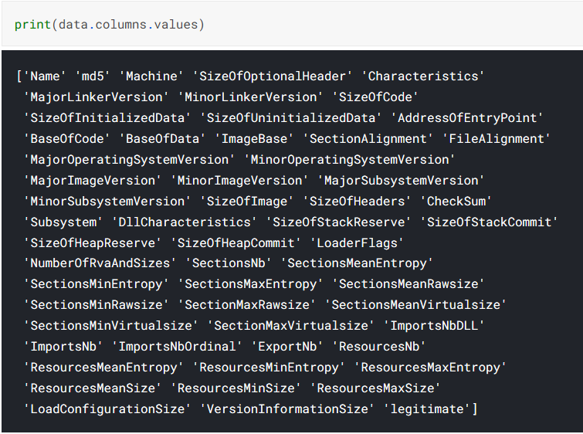
Feature Extraction
We used PE File header and then selected the optimal features using tree based feature selection approach, to train multiple models.

Slide 8
Machine Learning Models and Their Results

Slide 9
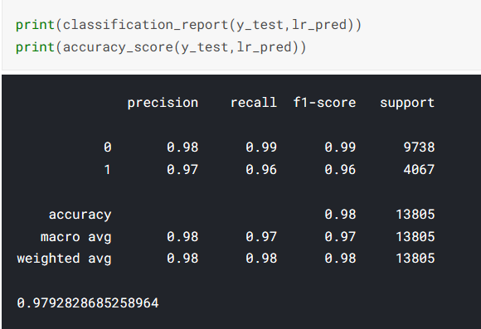
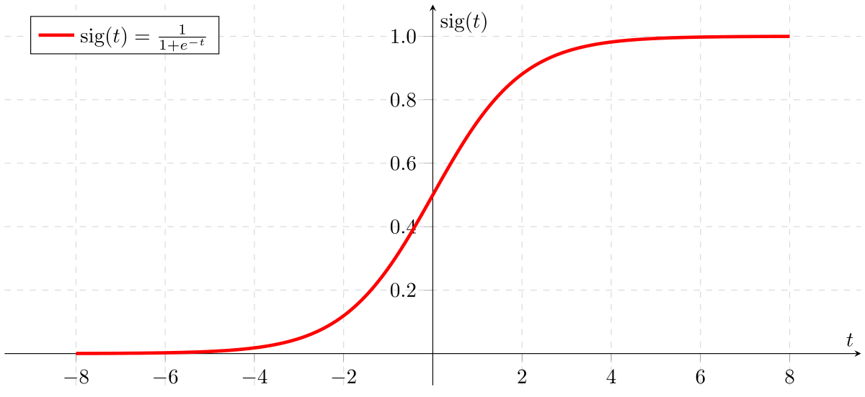
Logistic Regression
It is the most basic algorithm used in binary classification. It calculates the probability of a file belonging to one of the 2 classes.
Here we have used the “saga” solver, as it is a great option for large datasets along with “sag” solver where saga is also a great choice for sparse data. The drawback of “saga” is that it requires scaled dataset (normalised data), which was handled in preprocessing.

Slide 10
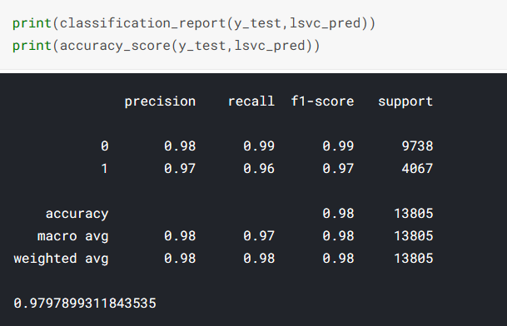

Support Vector Machine (SVM)
Support Vector Machines, predominantly a classification algorithm that can be utilised for both classification and regression analysis, uses the concept of a hyperplane to extrapolate the data to extended dimensions using multiple kernels. The algorithm based upon the concepts of width of the prediction margin which consequently depends on the support vectors in the dataset.

Slide 11
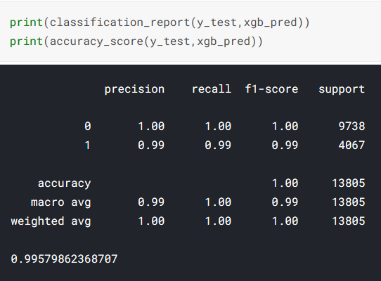
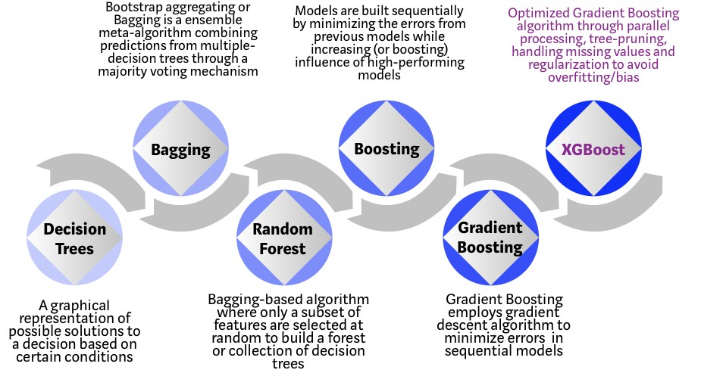
XGBoost
XG Boost is a tree based ensemble, Gradient Boosting Algorithm, which hence utilizes the capabilities of both the ensemble techniques of bagging and boosting. XG Boost is better than gradient boosting in terms of the optimized hardware utilization and the robust software.

Slide 12
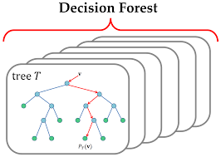
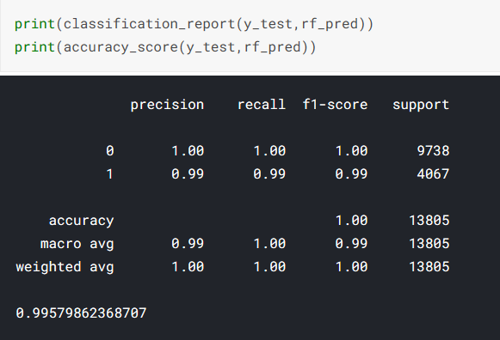
Random Forest
The random forest is another very famous ensembling technique that utilizes the randomised selection of features across multiple classification trees, which aids in the inclusion of all of the features without exceptional computational power and the problem of overfitting.

Slide 13
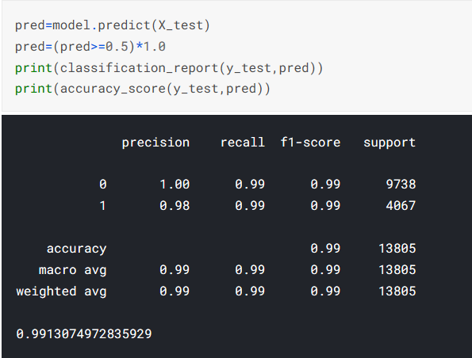

Artificial Neural Network
A simple artificial neural network consists of various hidden layers where each layer has some number of neurons.In an artificial neural network, the data passes through several layers of interconnected nodes, wherein each node classifies the characteristics and information of the previous layer before passing the results on to other nodes in subsequent layers.

Slide 14
Voting Classifier
We finally propose the usage of a Voting Classifier, an aggregation of the algorithms that performed exceptionally well on the dataset to account for any outliers or discrepancies in any one of the classifiers and uses a majority vote based approach to classify the file to be malware or legitimate. We utilised 3 algorithms to formulate the voting classifier viz. Random Forests, XGBoost and Artificial neural network, all of which scored an accuracy of above 99%.
XGBoost
Input Data
PreProcessing
Feature Extraction
Random Forests
Majority Vote
Artificial Neural Network

Slide 15

Deployment
We have created the source code and hence have also used colab to deploy the application, as we could utilize the gpu capabilities of Google Colab.
The application was created using streamlit and was wrapped to be hosted online using NGROK.
We have used streamlit to create and locally host the applications designed, and have used NGROK as a wrapper which can host the application over the web as well. The application would only be in the running state for the duration, when the application is hosted locally using Google Colab and streamlit.

Slide 16
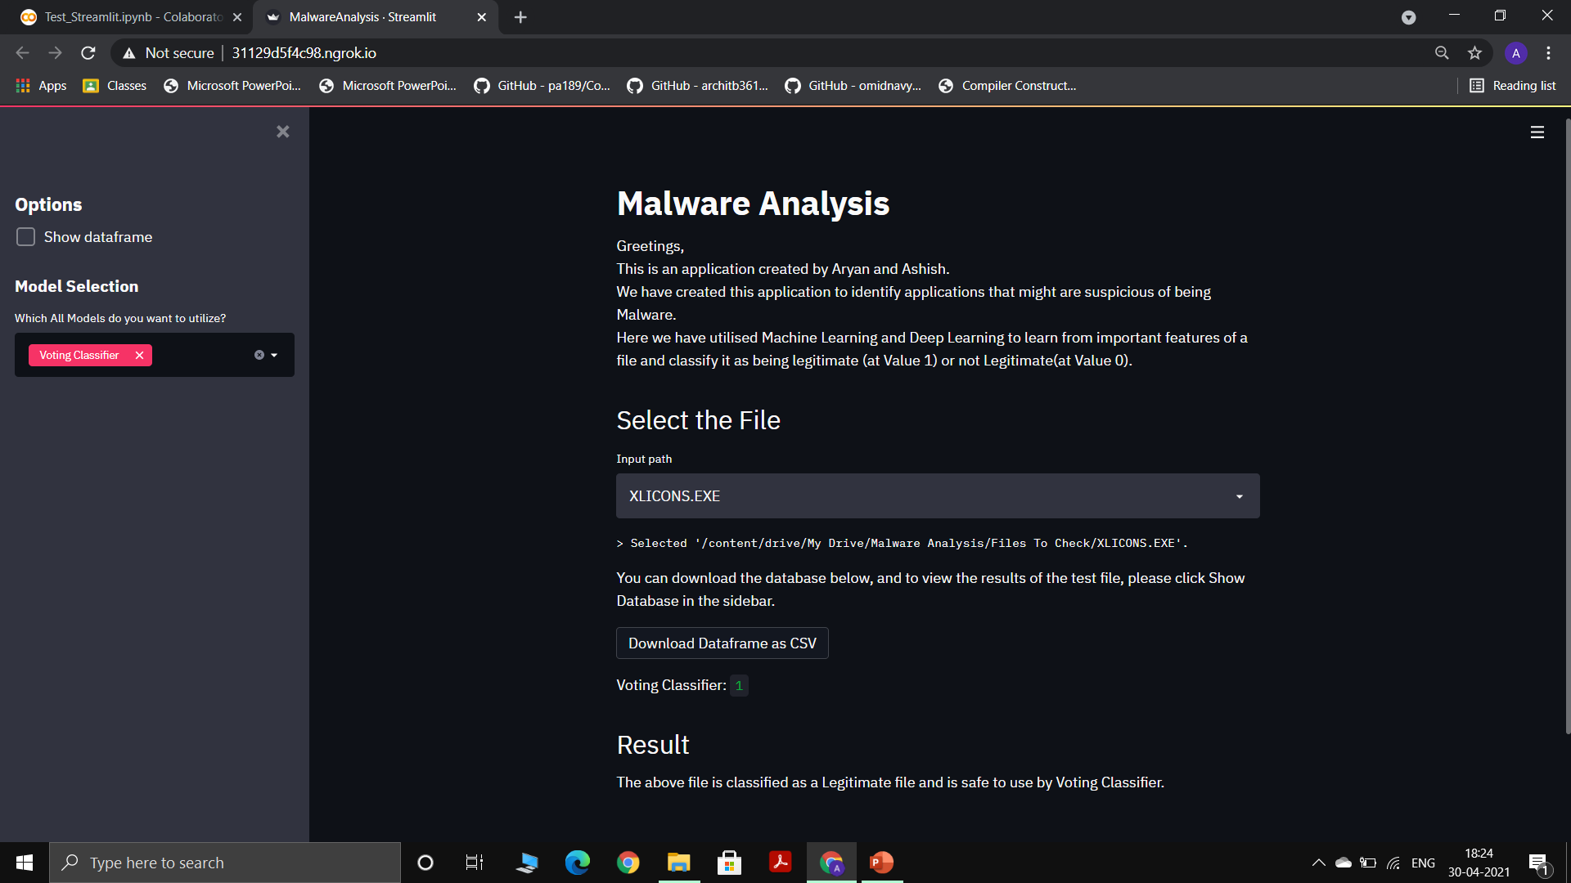
Deployment-Result

Slide 17

Conclusion
We have successfully created and deployed an aggregate machine learning classifier which utilizes the features extracted using PE File, the elements present in the PE header of a file which helped us to classify the file to be Malware or Legitimate.
We achieved the highest accuracy of 99.57% from Random forests and XGBoost both, followed by Artificial Neural Networks with an accuracy of 99.13%.
We successfully deployed the application using streamlit and hosted the application on the internet using NGROK.

Slide 18
References
I. Firdausi, C. lim, A. Erwin and A. S. Nugroho, "Analysis of Machine learning Techniques Used in Behavior-Based Malware Detection," 2010 Second International Conference on Advances in Computing, Control, and Telecommunication Technologies, Jakarta, 2010, pp. 201-203, doi: 10.1109/ACT.2010.33.
A. Walker and S. Sengupta, "Insights into Malware Detection via Behavioral Frequency Analysis Using Machine Learning," MILCOM 2019 - 2019 IEEE Military Communications Conference (MILCOM), Norfolk, VA, USA, 2019, pp. 1-6, doi: 10.1109/MILCOM47813.2019.9021034.
Sharma S., Rama Krishna C., Sahay S.K. (2019) Detection of Advanced Malware by Machine Learning Techniques. In: Ray K., Sharma T., Rawat S., Saini R., Bandyopadhyay A. (eds) Soft Computing: Theories and Applications. Advances in Intelligent Systems and Computing, vol 742. Springer, Singapore. https://doi.org/10.1007/978-981-13-0589-4_31
www.kaggle.com
www.ieeexplore.ieee.org

Slide 19
Thank You

